Slide 1

CONCEPTUAL DESIGN PRESENTATION

Slide 2

Hasan ÖZKARA CEO

Slide 3
Outline of the Presentation
Company Description
Introduction
Overall System Components
Video and Command Data Transmission
Motor Drive and Shooting Systems
Conclusion

Slide 4
Company Description

Slide 5
Members of the Company
TROY TECH
CEO
Hasan ÖZKARA
COO
Mert KAYIŞ
CFO
Kağan ÖZASLAN
CTO
Caner POTUR
CMO
Mustafa Ercan OKATAN

Slide 6
Mission & Vision
Mission: Our mission is to design and produce creative and reliable electronic Technologies and robotics meeting the desired specifications of customers under limited budget and time.
Vision: Our vision is to be a unique company consisting of highly motivated R&D engineers that create impressive robotic products with affordable and reasonable costs.

Slide 7
Introduction

Slide 8
Problem Statements
Controlling the ball
Shooting the ball to opponent’s goal
Defending the ball coming from opponent

Slide 9
Restrictions & Constraints
Teleoperation from at least 30 meters
Remote control
No crossing to the center-line
Ball transfer to opponent’s field in 20 seconds
Robot fitting into cylinder of diameter 65cm
Maximum budget of $200

Slide 10
Objectives
Objectives with regard to performance
Objectives with regard to marketing

Slide 11
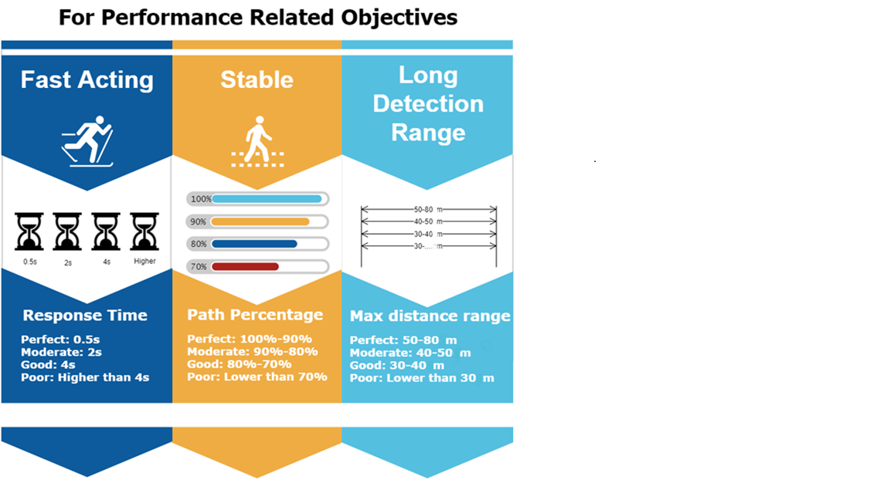

Slide 12
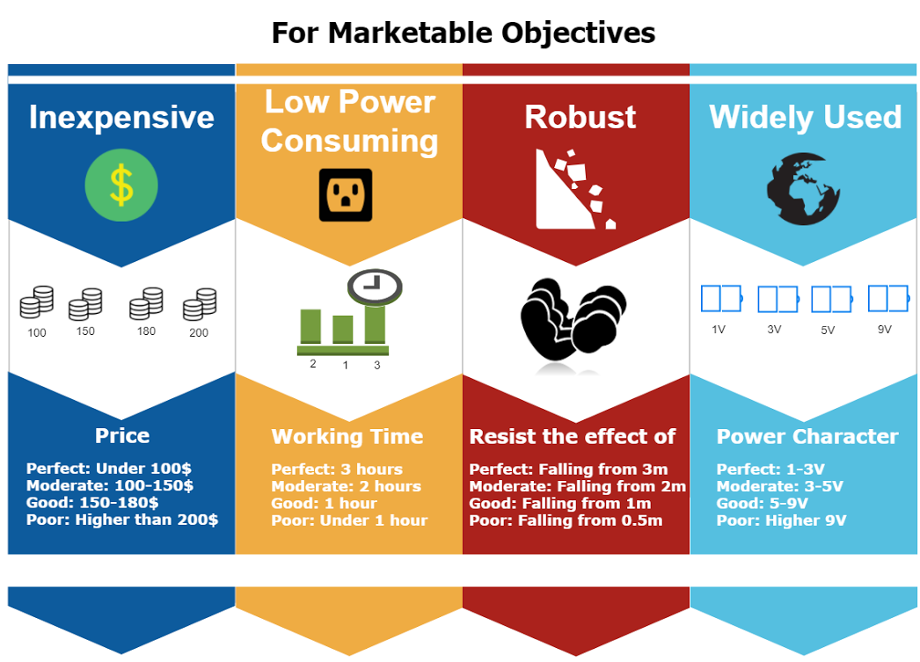

Slide 13

MERT KAYIŞ COO

Slide 14
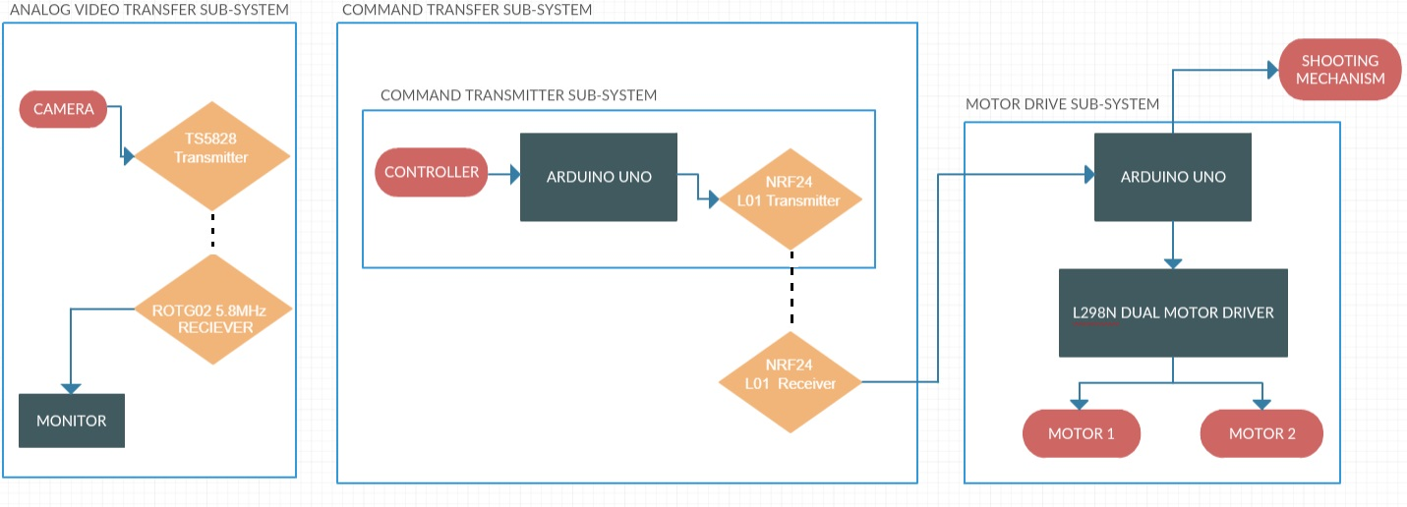
Overall Block Diagram

Slide 15
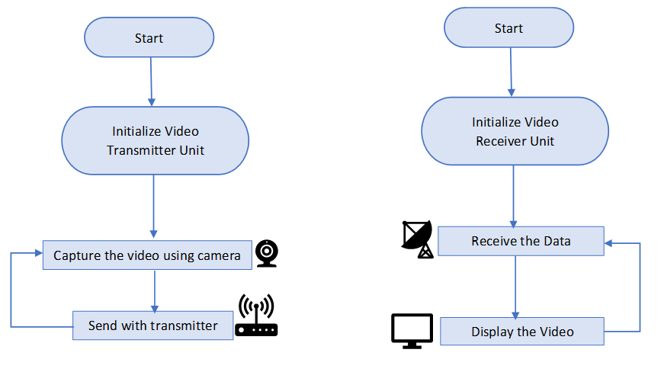
Flowchart for Video Transfer Subsystem
Continuous operation
Continuous operation

Slide 16
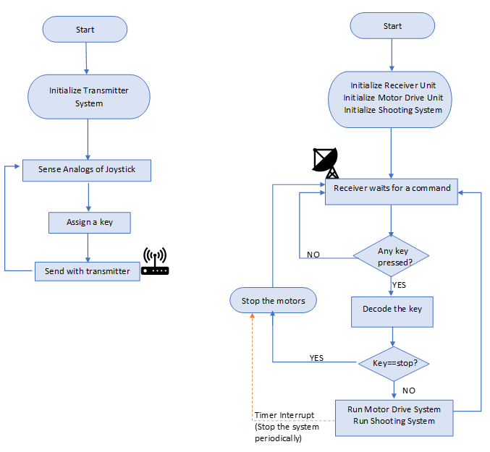
Flowchart for the Command Transfer Subsystem

Slide 17
Flowchart for the Command Transfer Subsystem

Slide 18
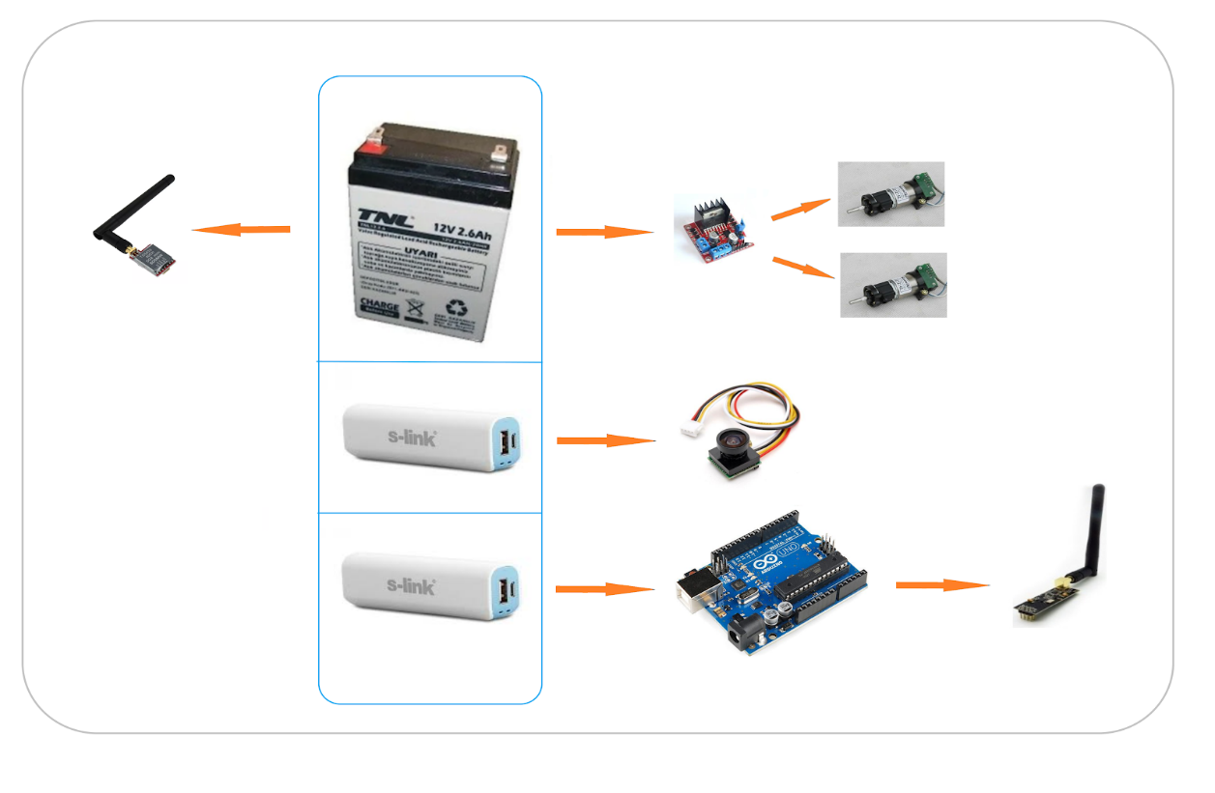
Power Supply Unit

Slide 19

KAĞAN ÖZASLAN CFO

Slide 20
Video Transmission
Command Transmission

Slide 21
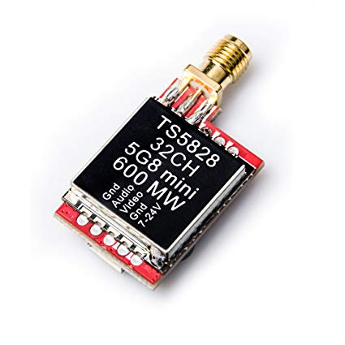
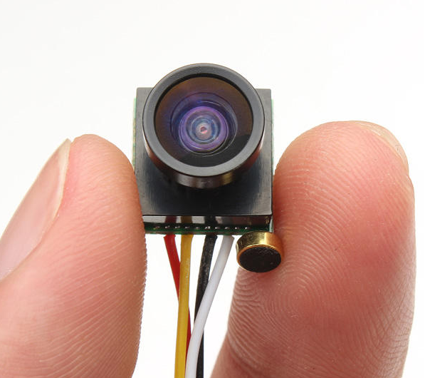
Video Transmission
5.8 Ghz
600mw Transmitter (TS5828)
40 Channel
27.5 dBm
170 degree camera

Slide 22
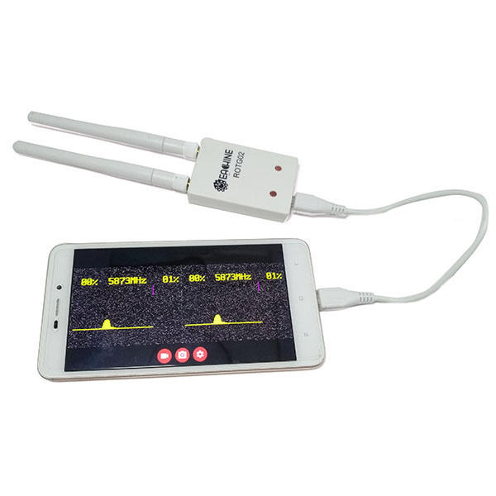
Video Transmission
5.8 Ghz Receiver (ROTG02)
Easy to use
Plug and Play with usb cable
150 Channel

Slide 23
Test Results
Outdoor = 500 m
Indoor = 50 m (from E Building Top Floor to D Building Study Hall)

Slide 24
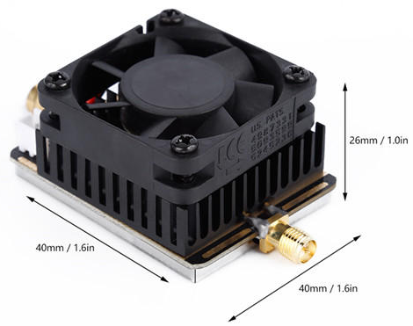
Test Results
Outdoor = 500 m
Indoor = 50 m (from E Building Top Floor to D Building Study Hall)
Improvement Option
5.8G Amplifier
27dBm to 34 dBm

Slide 25
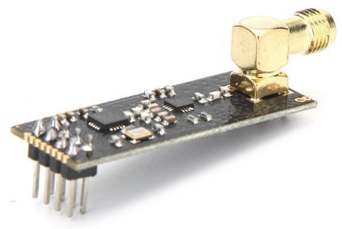
Command Transmission
2.4Ghz band
NRF24L01+ module
Very cheap (less than $2)
Compatible with high gain antennas
2.4ghz antennas are also very cheap
Secure communication protocol
100mW, legal to use

Slide 26
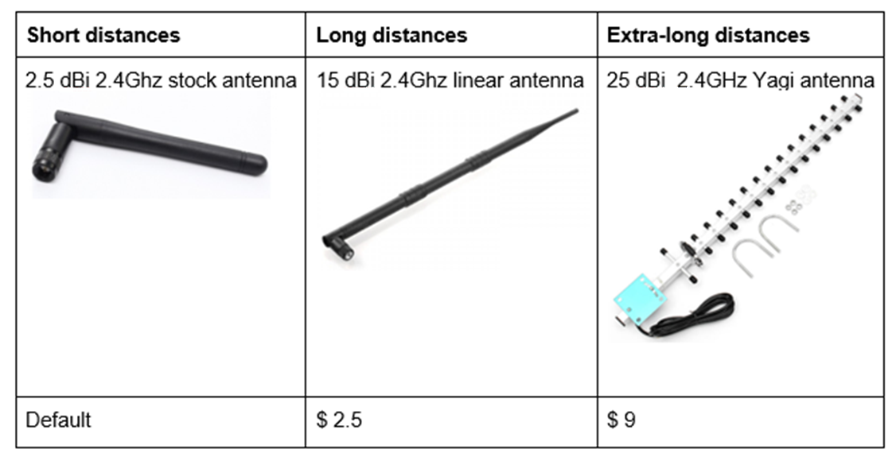
Command Transmission

Slide 27
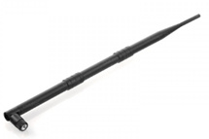
Test Results
NRF modules with 15dBi Linear Antennas
Outdoor = 1 km
Indoor = 100 m

Slide 28
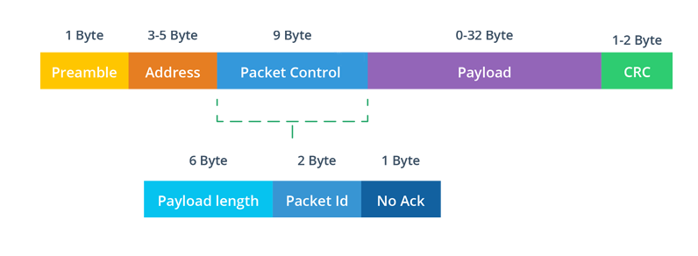
Communication Protocol

Slide 29
Preamble: Shows beginning of a packet.
Address: Shows the network pipe address.
Packet Control: Settings section.
Payload: Sending data is stored inside. Upon 32 byte.
CRC: Cyclic redundancy check for error detection.

Slide 30
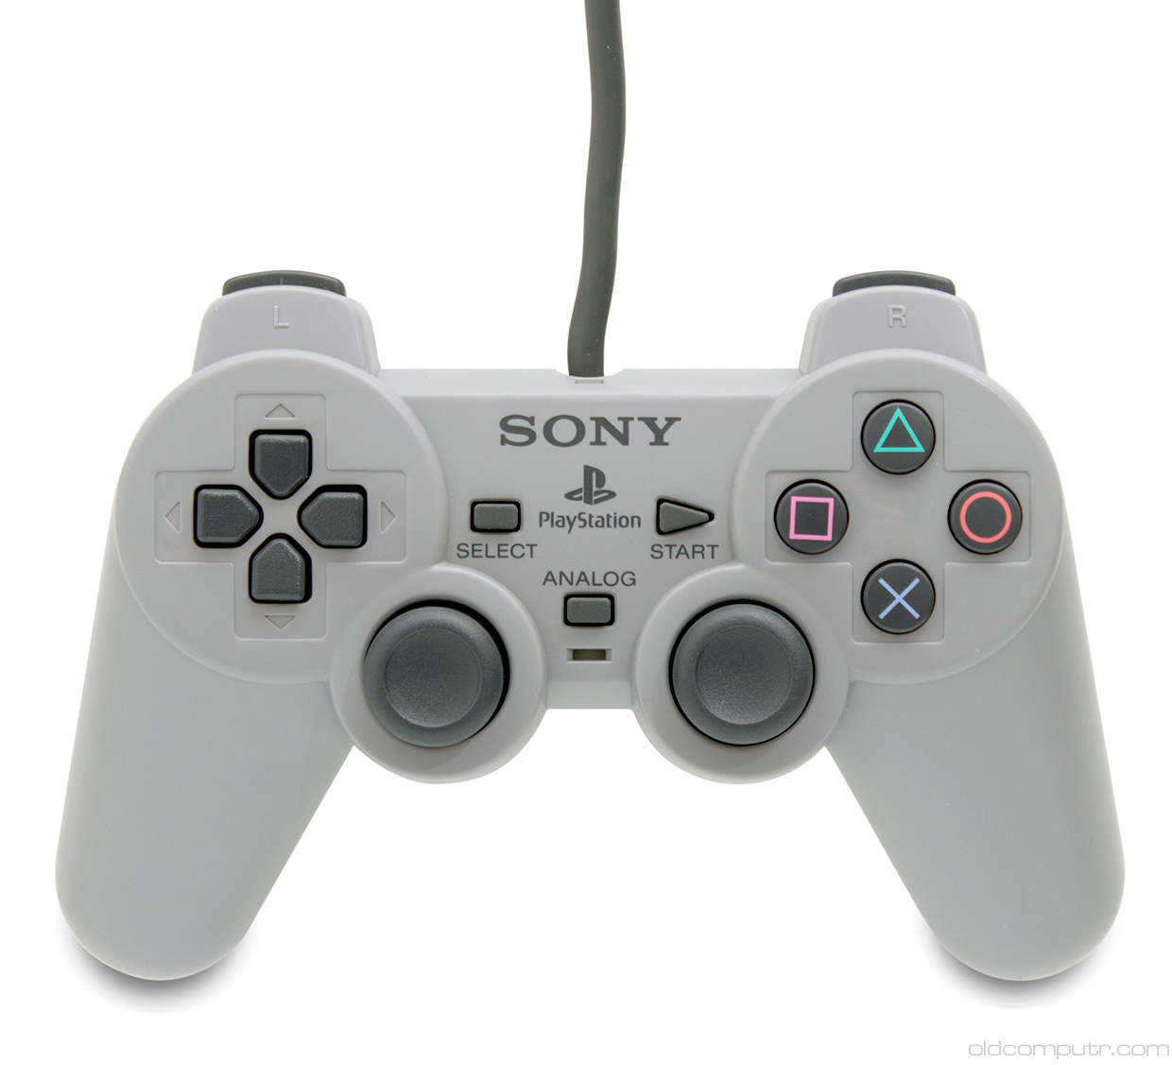

User Side

Slide 31

CANER POTUR CTO

Slide 32
Motor Drive System
Shooting System

Slide 33
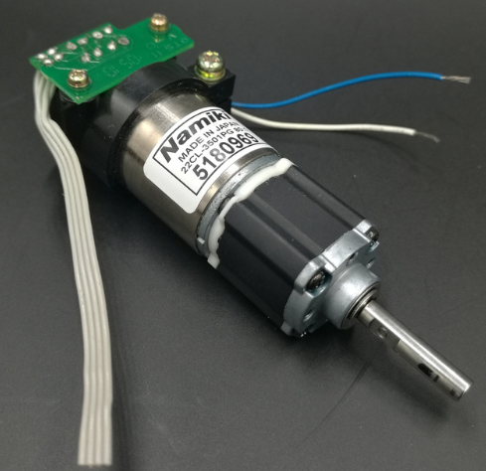
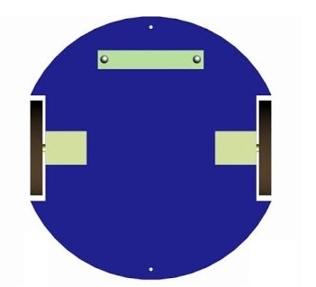
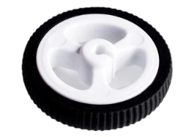
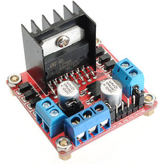
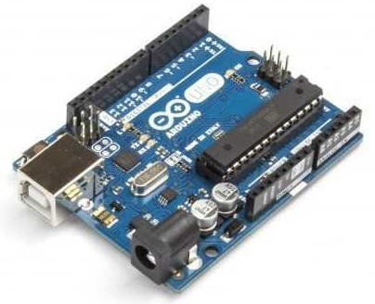
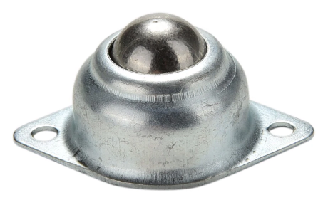
Motor Drive System: Differential Drive
Two DC motors
Two wheels
Two caster wheels
1 motor drive
1 Arduino Uno

Slide 34
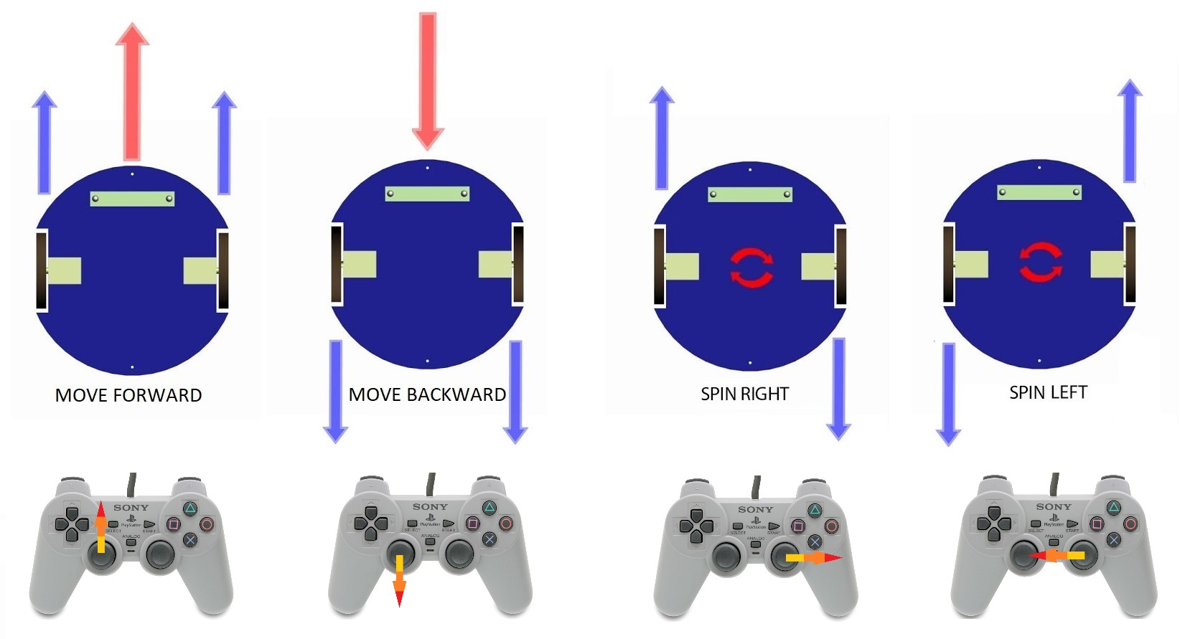

Slide 35
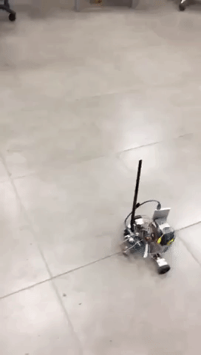

Slide 36

Defence

Slide 37
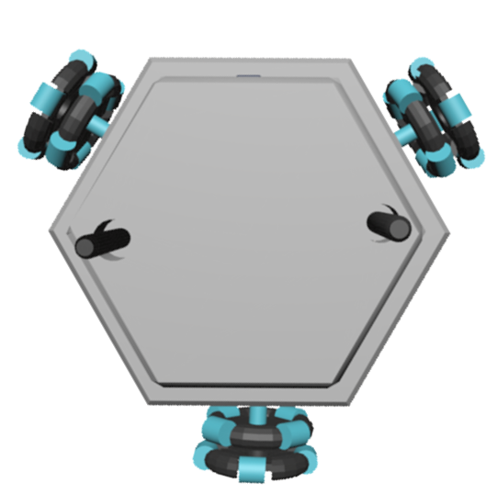
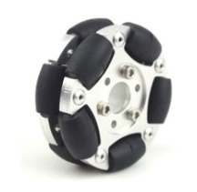
Alternate Solution: Holonomic Control
3 DC motors
2 motor drive
3 Omni wheels
1 Arduino Uno

Slide 38
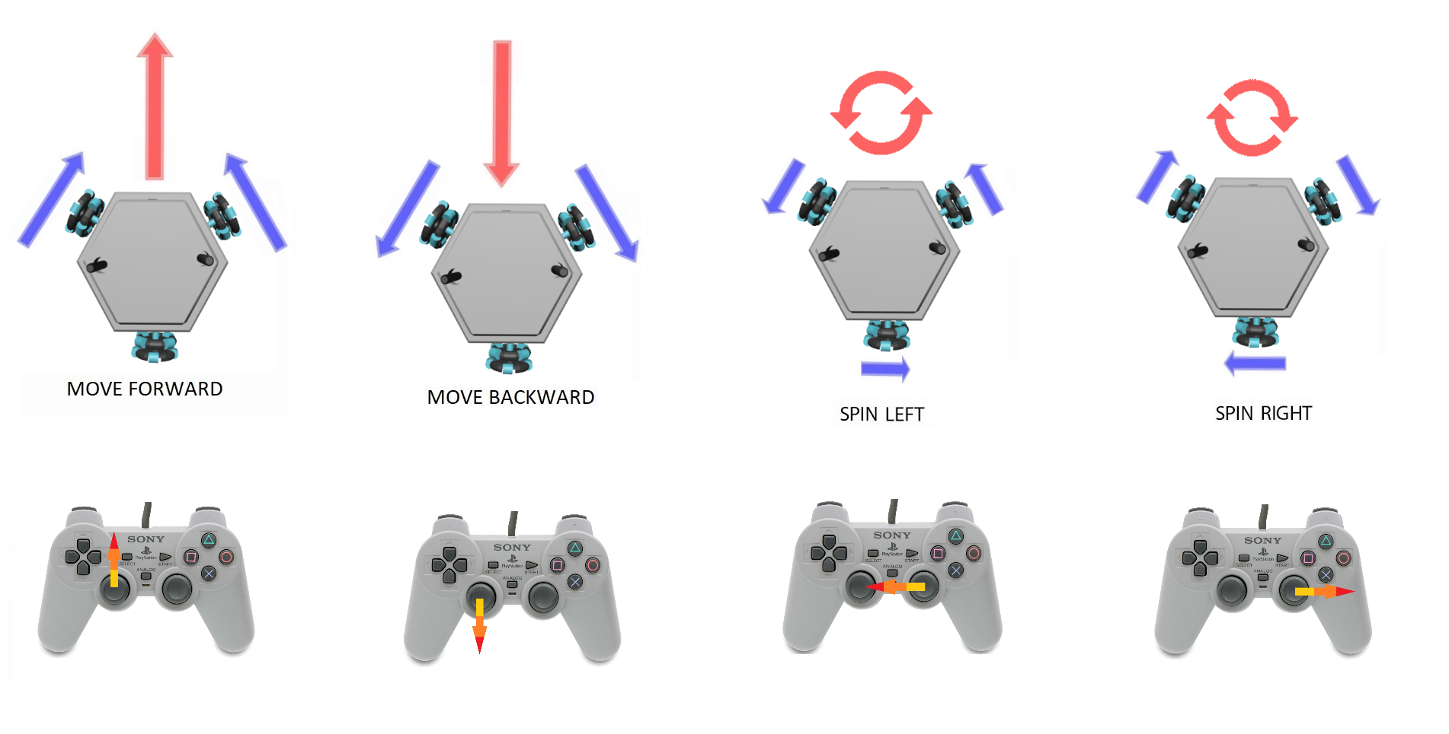

Slide 39
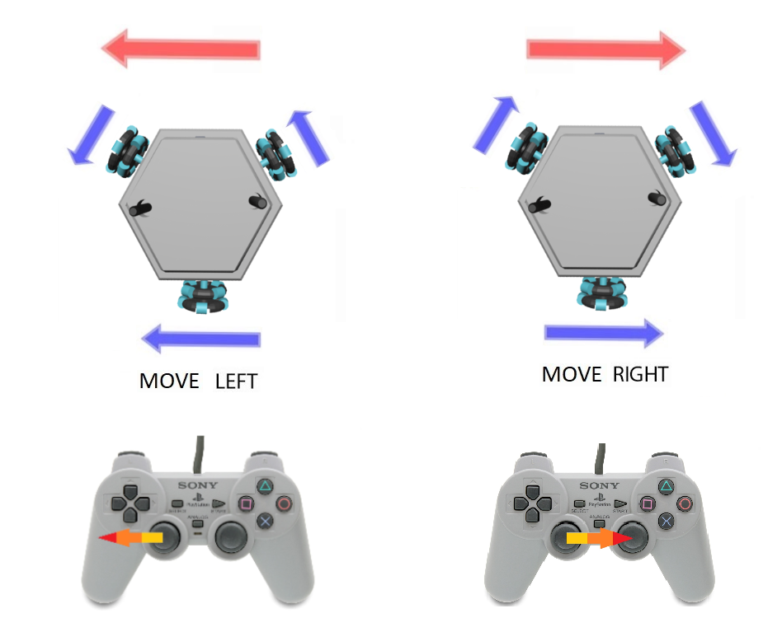

Slide 40

Shooting Systems

Slide 41
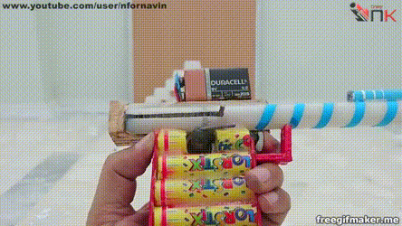
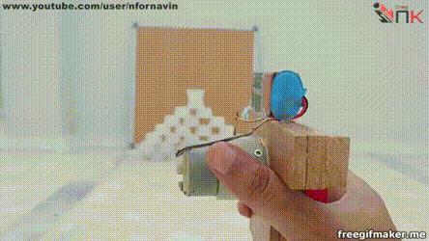
Spring Mechanics
Based on stored mechanical energy in a spring
Advantage:
Powerful shooting
Low Power Consumption
Disadvantage :
Slow reload

Slide 42
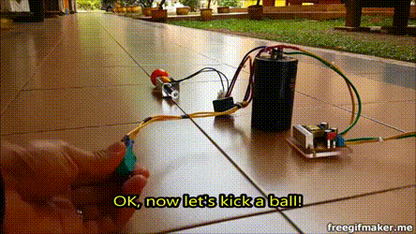
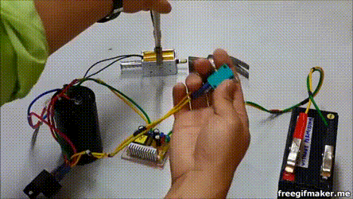
Alternate Solution: Solenoids
Based on creating a magnetic field by sending a current through a turn of wire
Advantages:
More powerful shooting
Small and lightweight
Disadvantages :
Operates at a high voltage and current,
Uses a lot of power
Due to internal resistance, heat is generated

Slide 43

Mustafa Ercan OKATAN CMO

Slide 44
Time Management
Financial Management
Deliverables

Slide 45
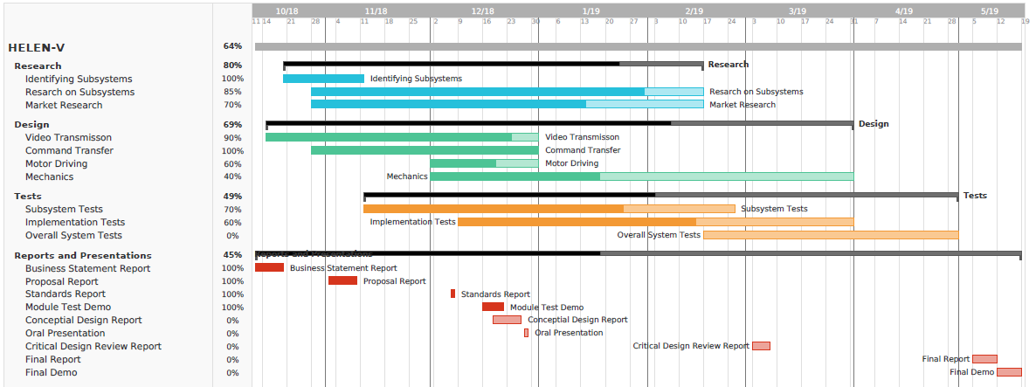
Time Management

Slide 46
Financial Management
Product | Pieces | Unit Price($) | Total Price($)
nrf24l01+ | 2 | 1.78 | 3.56
TS5828s | 1 | 7.70 | 7.70
Camera | 1 | 6.27 | 6.27
Video Receiver | 1 | 21.99 | 21.99
Arduino uno | 2 | 3.21 | 6.42
Joystick | 1 | 2.84 | 2.84
15dBi antenna | 2 | 2.24 | 4.48
12V Battery | 1 | 9.55 | 9.55
Power-bank | 2 | 4.75 | 9.50
DC motor | 3 | 8 | 24
L298n | 1 | 1.43 | 1.43
Omni Wheel | 3 | 8.55 | 25.65
Connection equipment and body | 1 | 10 | 10
Estimated cost of the shooting mechanism |  |  | 10
Unexpected costs |  |  | 20
TOTAL | 17 pcs |  | 163.5

Slide 47
Deliverables
1 X Robot: HELEN-V
1X User manual
a certificate of warranty
2 X Ball
6 X wall of the playfield
2 X Substitute battery

Slide 48
Conclusion

Slide 49
Thank you for listening

Slide 50
REFERENCES
Hamby, C. (2013, November 26). Top Benefits And Top Disadvantages To Using A 5.8 GHz Frequency? Retrieved from https://www.avalan.com/blog/bid/354696/Top-Benefits-And-Top-Disadvantages-To-Using-A-5-8-GHz-Frequency
Perlman, A. (2016, August 20). Everything You Need to Know About FPV Flying. Retrieved from https://uavcoach.com/everything-need-know-fpv-flying/
User’s Basic Guide to Radio Control Systems. (n.d.). Retrieved from http://www.rcmodelswiz.co.uk/rc-guides/electric-rc-models-guide/users-basic-guide-to-radio-control-systems/
Wheel Control Theory. (n.d.). Retrieved from http://www.robotplatform.com/knowledge/Classification_of_Robots/wheel_control_theory.html

